Slide 1
Iteration Management – Your Key to Predictable Delivery
By Jon Kruger
(@JonKruger)

Slide 2
What is Iteration Management?
Not the same as project management
Identify team problems as soon as possible and find a way to fix them
Help the team become as efficient as possible
Help with planning and estimating
Communicate with management
Notes:
Iteration management is the art of managing the estimating, planning, and execution of a software development project over a short period of time, whether this is done individually or in a team environment.
Iteration managers vs. project managers
Unblocker
How to spot someone being blocked
Optimize efficiencies – let team members focus
Help the team work as a team (not silos)
Handling changes (from the business, production support, etc.)
Not necessarily a full time job, usually done by someone on the team
Tips I’ve learned

Slide 3
Management wants things done quickly
… and predictably
Notes:
Management doesn’t like surprises
Need to be able to deliver consistently

Slide 4
What’s an iteration?
Notes:
Small, defined amount of time (scrum)
Continuous flow of work (kanban)

Slide 5
What if I’m not an Agile project?
Notes:
How many of you are working in an agile environment?
This is not a talk about Agile
You don’t have to be in an Agile environment to do these things, although Agile practices make this a lot easier
The goal is to find problems as soon as possible so that you can address them

Slide 6
What if I’m not a team lead?
Notes:
Think of yourself as a team of one – apply principles

Slide 7

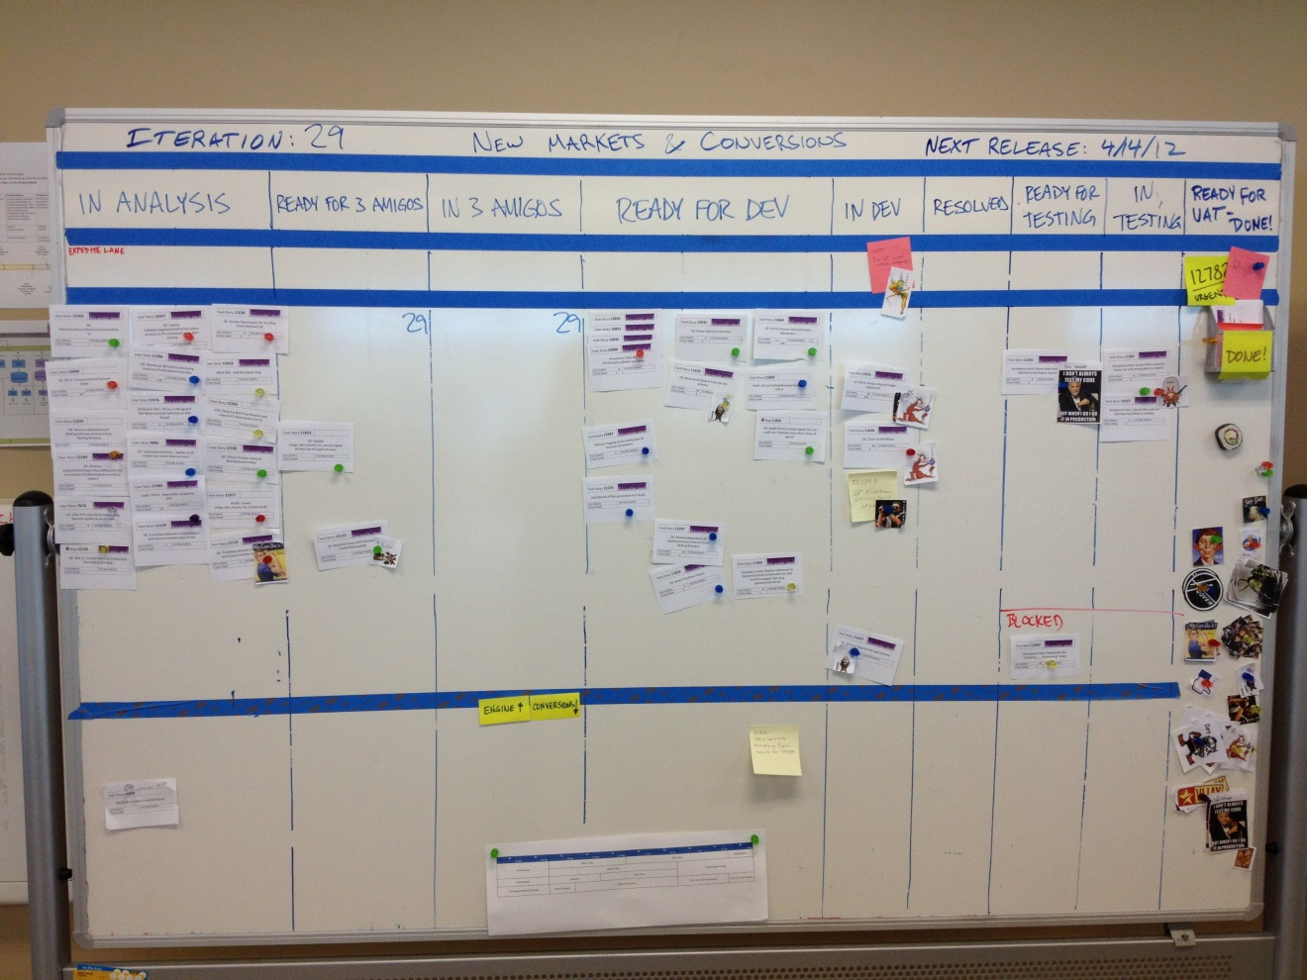
The Board
#1
Notes:
Physical board vs. online tools
Use the board to see how things are going and when problems occur

Slide 8
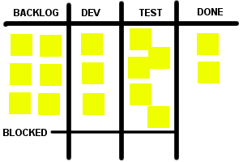
What is this board telling you?
Notes:
In this example, we can easily see that we are either developing things faster than we can test them, or things are getting stuck in testing due to bugs. We may need to assign more people to testing or work on reducing bugs.

Slide 9
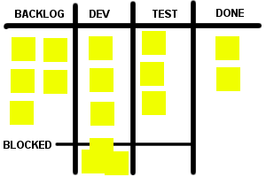
What is this board telling you?
Notes:
There are a lot of features that are blocked. We should try and address the blocking issues and look and see if there is some greater problem that is causing things to get blocked.

Slide 10
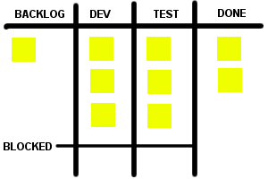
What is this board telling you?
Notes:
We don’t have much in our backlog, so the developers are going to be out of stuff to do really soon. We may need to get more people working on requirements gathering.

Slide 11
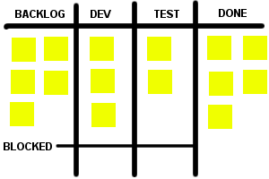
What is this board telling you?
Notes:
Things are flowing pretty smoothly. We have a good sized backlog, no blockers, the work is evenly distributed, and we’re getting a lot done.

Slide 12
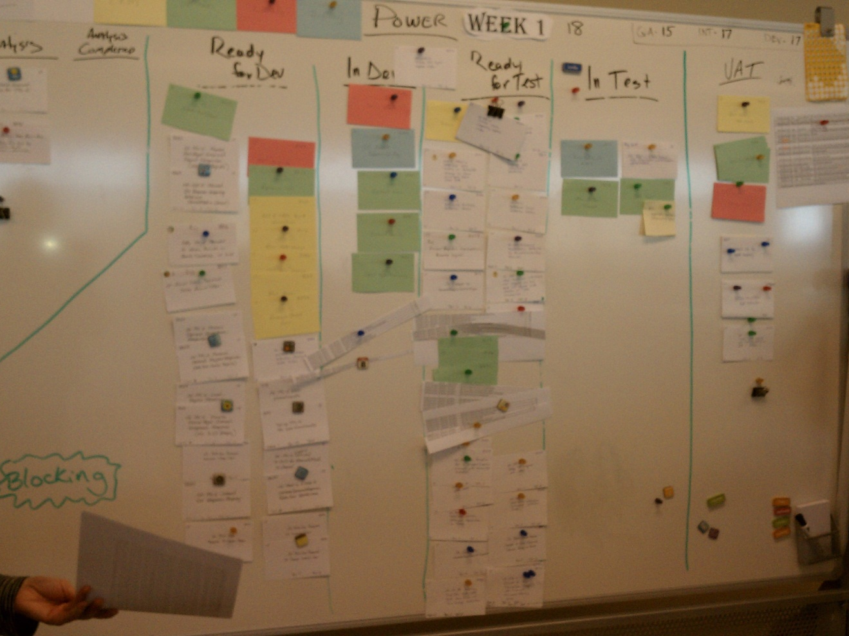
What is this board telling you?

Slide 13
Managing the Iteration
#2
Notes:
See the big picture – allow your team members to be heads down
Be the unblocker
Keep things flowing – blockers, people stuck
Finding the bottlenecks
Definition of Done
Finishing the iteration – cut off dev

Slide 14
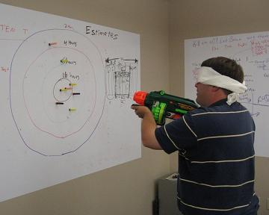
Estimating
#3
Notes:
“Estimates are always wrong” – business needs better that this
You know that estimates will be interpreted as commitments, this should not surprise you anymore
Small tasks are easier to estimate (how small is up to you)
3 amigos
People doing the work should do the estimates
Estimate QA and analysis too

Slide 15
Estimation Methods
Time (hours/days)
Story Points
Counting tickets
#NoEstimates
Notes:
Pros and cons of each

Slide 16
Estimation Methods
Time (hours/days)
Story Points
Counting tickets
#NoEstimates
Notes:
Pros:
Makes sense, people are used to it
Easier if you know the app/business/subject matter well
People doing the work do the estimating

Slide 17
Estimation Methods
Time (hours/days)
Story Points
Counting tickets
#NoEstimates
Notes:
Relative to other features
Pros:
Easier if you don’t know the app/business/subject matter well
People better at estimating relative size than actual size
People might estimate different hours but same relative size
Cons:
Estimating in arbitrary sizes can be awkward
People tend to convert to hours in their head

Slide 18
Estimation Methods
Time (hours/days)
Story Points
Counting tickets
#NoEstimates
Notes:
Estimates are usually wrong
Break all tickets down into small enough sizes and the variance in sizes averages out
Need to have less variance in tickets
Alternative – T-Shirt sizes (combination of counting tickets and story points)

Slide 19
Estimation Methods
Time (hours/days)
Story Points
Counting tickets
#NoEstimates
Notes:
Estimation is a waste of time, just do the most important work now – I don’t know that this is always practical
Works well if you handle work as it comes to you
Works well if the majority of the tickets aren’t known when the iteration starts
e.g. production support

Slide 20
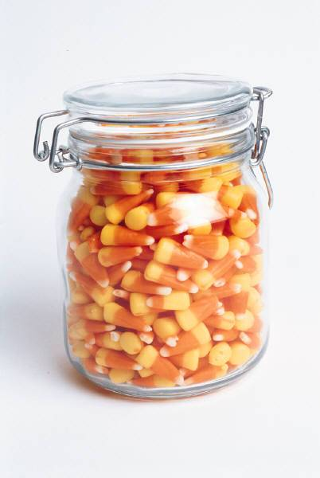
How many in the jar?

Slide 21

How many in the jar?
250

Slide 22

How many in the jar?
250
90
Notes:
It becomes much easier to estimate once we have data that can help us determine the right answer.

Slide 23
Data Analysis
#4
Notes:
Past experiences with data analysis (Avizent, AEP, utilization % by category)
Get better at estimating and planning
How will you know if you’re estimating correctly?
Control variables
Team members not changing, fully allocated
Smaller teams
Expect the unexpected
Consistent hours/accounting for all hours
Track everything!
Tracking estimates vs. actuals

Slide 24
Data Analysis …at the personal level
Notes:
- Track everything you do
- % time per activity – estimate this too!
- difference between 50% and 60%
- "invisible time" - time doing things without recording what it went towards
create tickets for everything
Compare estimates vs. actuals
- Danger – things filling up your day
- Limit meetings so that you can have as much time to get work done as you committed to

Slide 25
Capacity Planning
#5
Notes:
How much can we commit to, and what should we work on?
Tickets should already be estimated (incl. analysis, testing)
% person’s time in each discipline for moving tickets? (separate by project)
Account for time off, special meetings, etc.
Expected time needed for new scope, prod support, etc.
Normal working hours
Break the team into smaller teams (or sub-teams)
Each sub-team can do their own capacity planning
Start with a gut feel, and then adjust your gut feel estimate based on data and experiences

Slide 26
Metrics
#6
Notes:
Things you track that you might share with others to communicate status

Slide 27
Metrics
Data has no value on its own, the value is in the interpretation of the data.

Slide 28
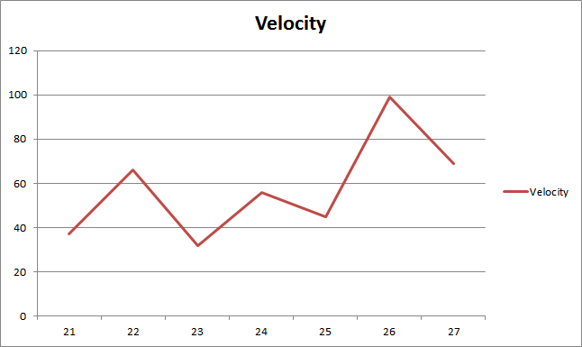
Data and Interpretation
Notes:
What can you conclude from this chart?
Average velocity is 58
The last two iterations have been good so we can do better than 58
Absolutely nothing!

Slide 29
Internal Metrics
Estimates vs. actuals
Points/hours planned for vs. points/hours completed in an iteration
Points/hours completed in an iteration (velocity)
Cycle time
Notes:
Things I’m going to track to help me plan/estimate
Not going to share (outside the team)

Slide 30
Internal Metrics
Work that comes into the iteration after the iteration starts
How much work gets pushed out of the iteration
Number of hours worked over 40 hours
Percentage of time spent on analysis, development, testing, and everything else
User happiness

Slide 31
Velocity
Notes:
Velocity affected by variables
Capacity is better
Start with a gut feel and refine it
Estimates vs. actuals at the feature level
Work that comes into the iteration after the iteration starts (excluding even swaps of one feature for another) – for example, this could be bugs, production support, etc.
Percentage of time spent on analysis, development, testing, and everything else
Points/hours planned for vs. points/hours completed in an iteration
Planned vacations, holidays, or other unusual events
Velocity is an internal metric, my capacity estimate is the interpretation of velocity (and other data)

Slide 32
External Metrics
Notes:
What do people want to know, and why?
Posted metrics can distract the team from the goal
Have a really good reason for posting metrics

Slide 33
Bad Metrics
Notes:
Anything that compares team members
Anything that encourages competition vs. working together

Slide 34
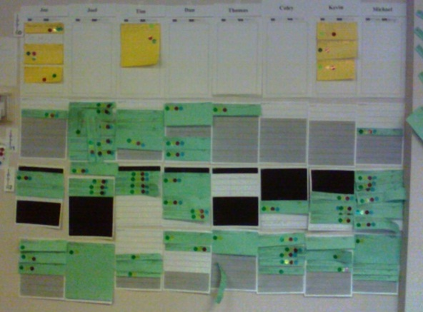
Implied Metrics
Notes:
This incentivizes developers to get as many features to QA as possible (quality doesn’t matter, helping others doesn’t matter)

Slide 35
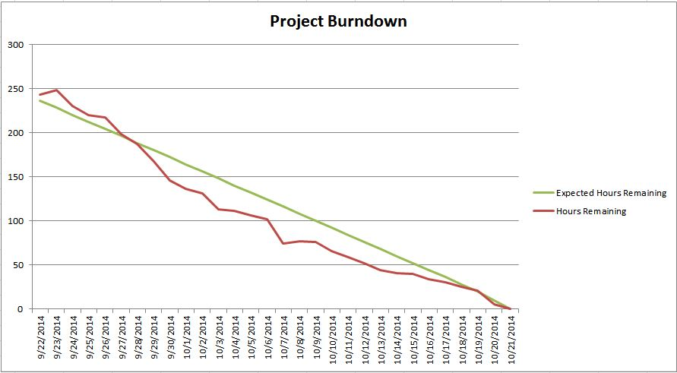
Burndown Charts
#7
Notes:
Basic burndowns
Project level vs. iteration level

Slide 36
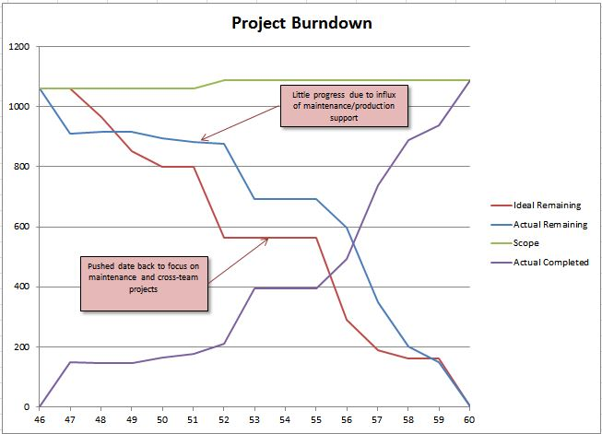
Burndown Charts
Notes:
Total scope line
Actual completed line (“burn-up”)
Callouts
“Ideal Remaining” line reflects the project schedule

Slide 37
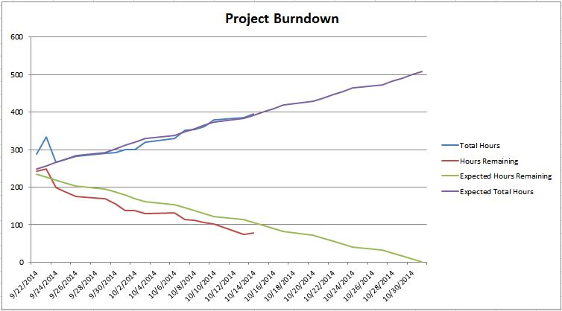
Burndown Charts
Notes:
How would you interpret this?

Slide 38
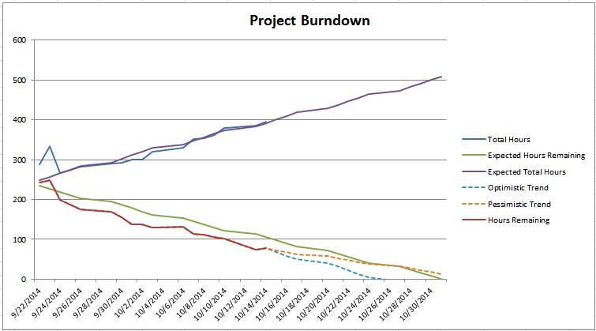
Burndown Charts
Notes:
Showing optimistic/pessimistic trend

Slide 39
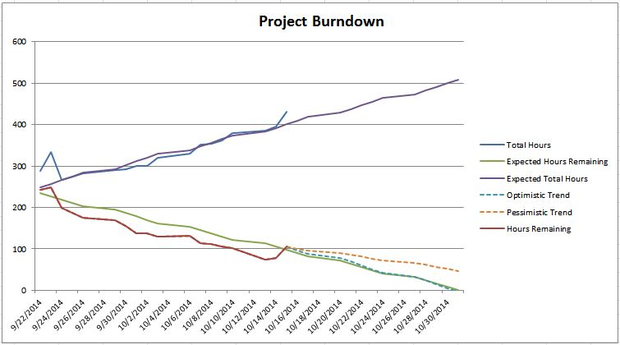
Burndown Charts
Notes:
What it looks like after the bump in the road

Slide 40
Should you post a burndown chart?
Notes:
Find out what questions they really want answered, then just tell them the answer
Burndowns still leave lots of room for interpretation

Slide 41
Involving Stakeholders
#8
Notes:
Product owners
Let the business pick what you work on
Include the business in the meeting, or meet with the before, whatever works
Set goals for the iteration
Swapping things out during the iteration
Demos/UAT

Slide 42
Managing the Backlog
#9
Notes:
Managing backlog
how far out should you accurately plan? (depends on how far out you have to commit)
- will this ticket ever be worth our time?
- let the business keep the backlog. Each iteration they can choose what to give you from their backlog.
- There's a cost to every ticket in the backlog (you have to estimate it, talk about it, keep track of it, discuss it again)

Slide 43
Working with Management
#10
Notes:
Understand how they like to plan
What is important to them (quick to market, level of quality, involvement from users, etc.)
Estimate often equals “commitment”
If you don’t provide an estimate, one will be made up for you!
You define “normal” for your team (predictability) – “invisible time”
Cost isn't the only thing that matters, ability to change quickly matters

Slide 44
Keeping Up
Notes:
Riding waves
Rookie QBs
Keep everything in front of you

Slide 45
The only rule
Do more of what works and less of what doesn’t.

Slide 46
Questions
?

Slide 47
Slides and contact info
Slides:
http://jonkruger.com,
click on Presentations
Blog Series:
http://jonkruger.com/iteration-management
Email: jon@jonkruger.com
Twitter: @JonKruger
Blog: http://jonkruger.com

